Slide 1
以遊玩特徵為導向的 程序化內容生成方法
Advisor: Prof. Wen-Kai Tai
Student: Ze-Hao Wang

Slide 2
Agenda
Introduction
Related Works
Mission / Space framework
Map Sketches & Evolution of Segments
Proposed Methodologies
System Architecture
Mission Grammars
Room Definitions and Instruction
Genetic Algorithm in Segments Evolution
Experimental Results
Conclusions and Contributions
Future work

Slide 3
Introduction

Slide 4
Motivation
[會再翻成英文]
程序化內容自動生成 (Procedural Content Generation) 在過去就廣泛被應用於遊戲設計領域，其主要目的為增加遊戲內容的隨機性與多樣性。我們預期讓玩家在進行遊戲時能夠遵循關卡設計師的劇情脈絡外，亦能夠體驗到有意義且多樣化的遊戲關卡內容。

Slide 5
Research Goals
[會再翻成英文]
我們針對遊戲過程中的遊玩特徵 (gameplay patterns) 進行抽象化，使用程序化生成技術產生帶有意義遊戲關卡內容，藉此消彌或降低因隨機性所產生的不穩定要素，以改善並豐富遊戲體驗。

Slide 6
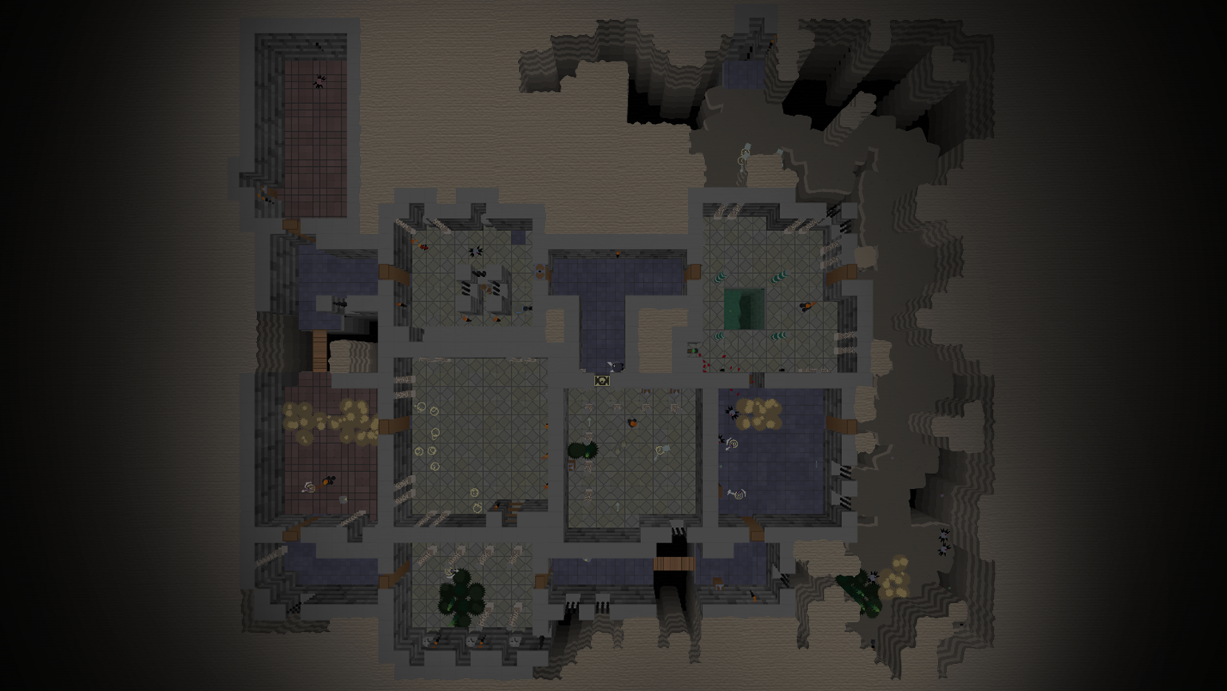
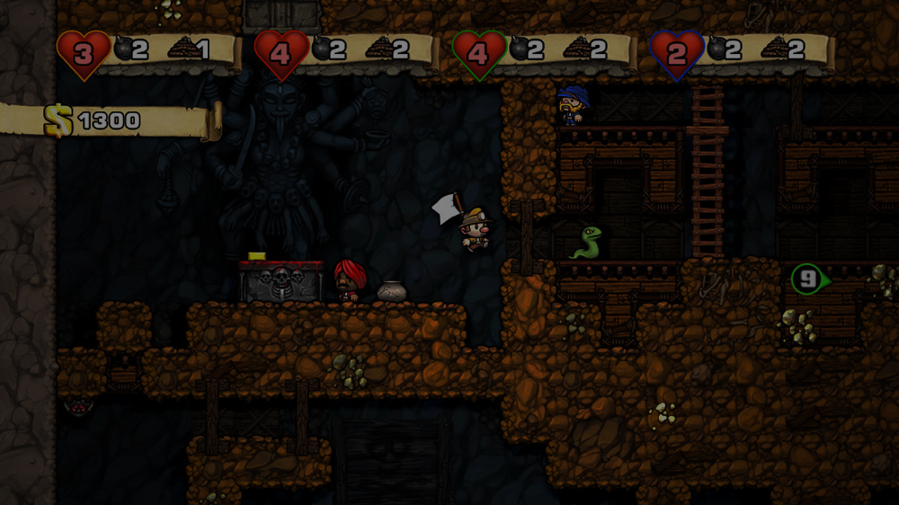
Related Works
Mission / Space framework
Map Sketches & Evolution of Segments

Slide 7
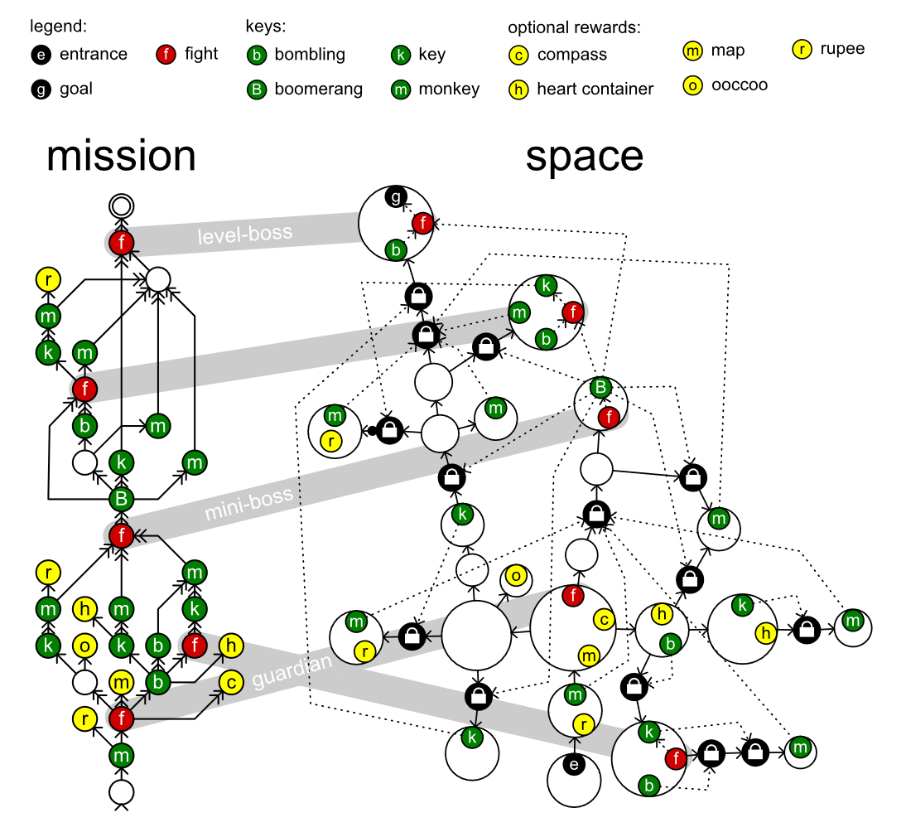
Mission / Space framework
Mission/Space framework, focuses on level design and the mechanics that control player progression through a game.
Transformational Grammars
Mission Grammars
Space Grammars
Mission Graph Convert into Space Graph

Slide 8
Transformational Grammars

Slide 9

Mission Grammars
Inhibitions
Available when at least one of the weak prerequisites is completed.
Strong requirement
Available when all strong prerequisites are completed.
Weak requirement
Available when at least one of the weak prerequisites is completed.
Example of mission graph
Mission graphs represent the players’ progress towards a goal not by tracking their physical location, but by tracking the tasks they must perform to finish a level.
A mission graph is a directed graph that represents a sort of to-do list with each node representing a task that might or must be executed by the players.

Slide 10
Space Grammars
k
t
g
t
k
e

Slide 11
Mission Graph Convert into Space Graph
The steps in the generation progress investigated in this paper in detail:
An alternative method, does not go into detail:
Mission
Map
Space
Refine
Level
Create
Space
Distill
Mission
Adjust
Space
Refine
Level
Create

Slide 12
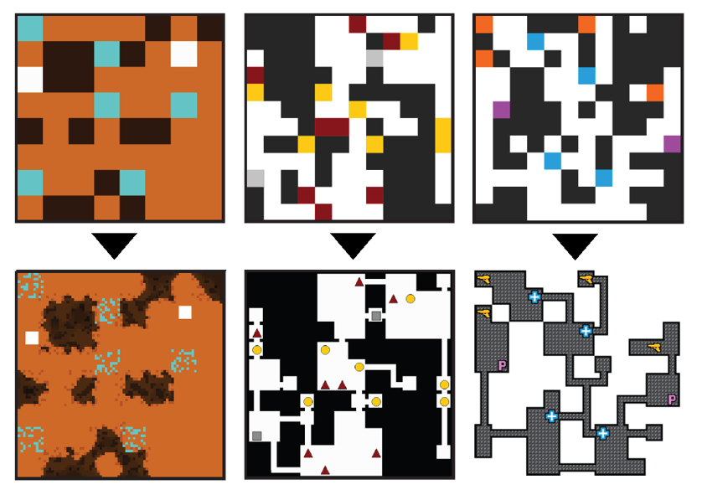
Map Sketches & Evolution of Segments
.
Map Sketches
Map Sketch Evolution
Dungeon Segments
Dungeon Segment Evolution

Slide 13
Map Sketches

Slide 14
Map Sketch Evolution

Slide 15
Dungeon Segments

Slide 16
Dungeon Segment Evolution

Slide 17
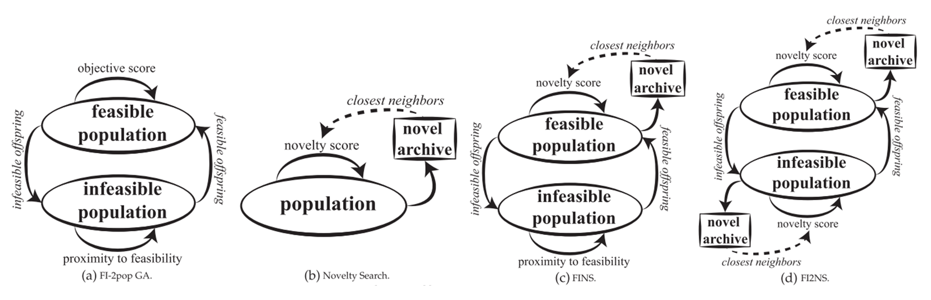
Constrained Novelty Search

Slide 18
Proposed Methodologies

Slide 19

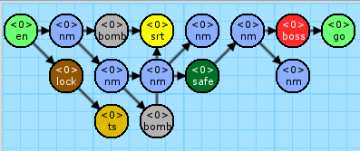


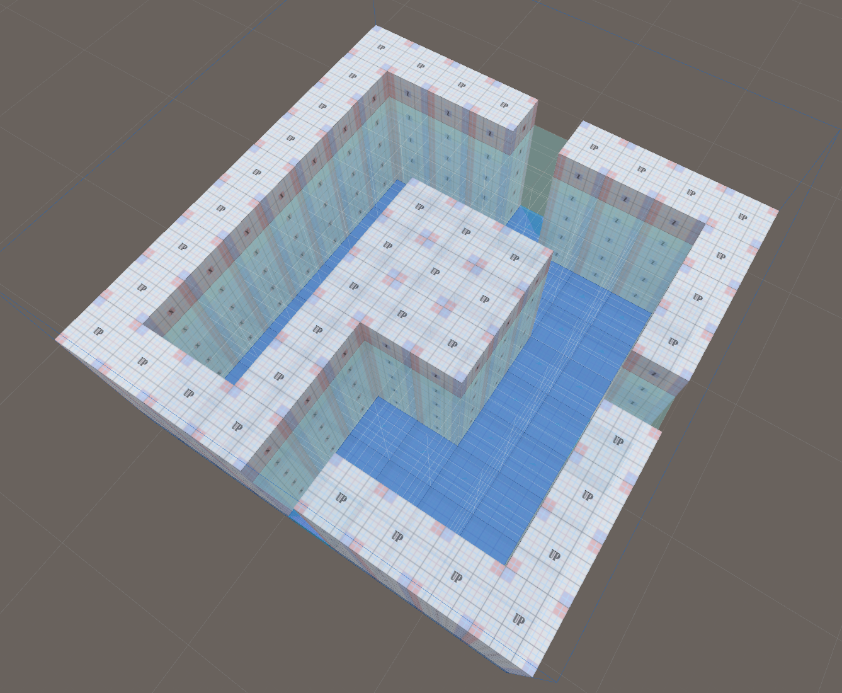
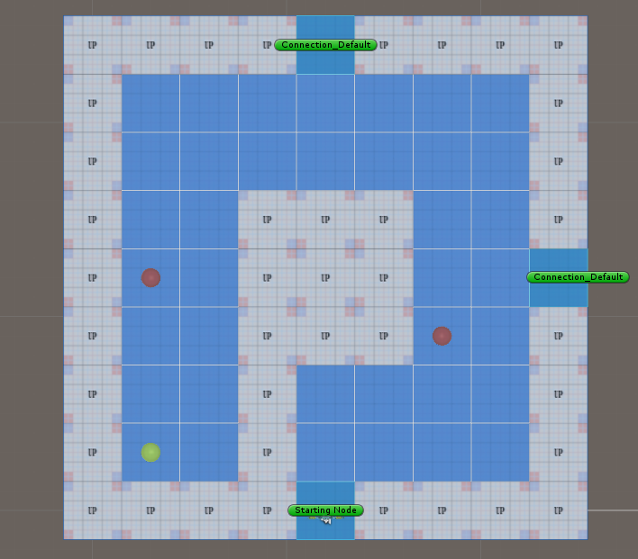
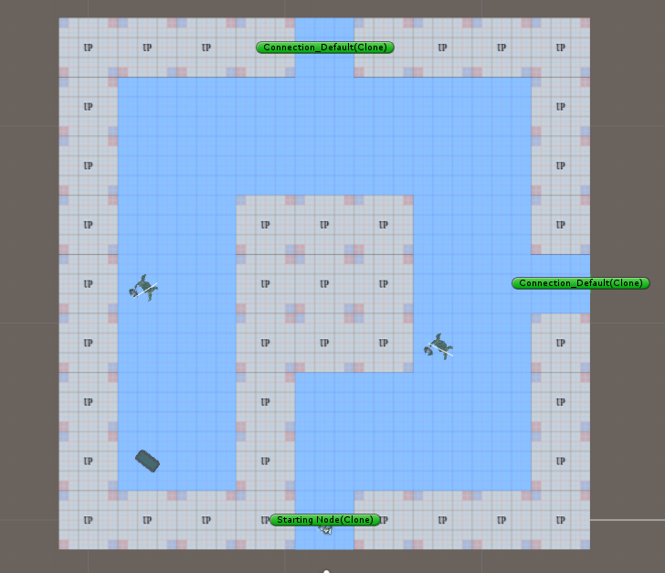
System Architecture
- Phase 1 - Mission / Space framework
- Phase 2 - Dungeon Segment Evolution
圖片 需更換

Slide 20
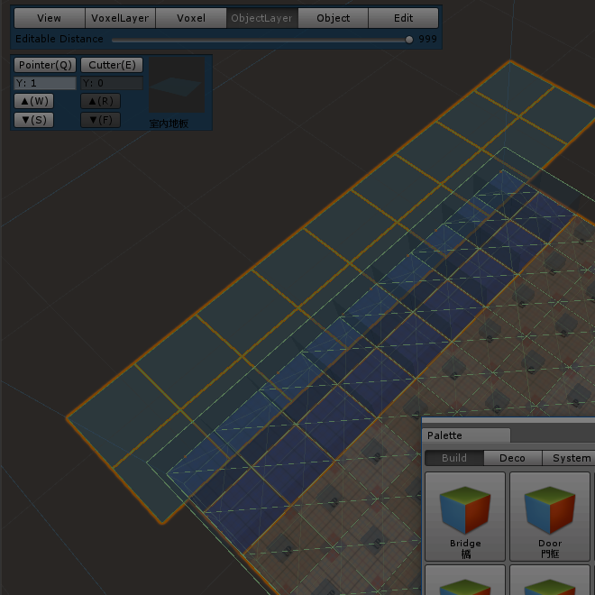
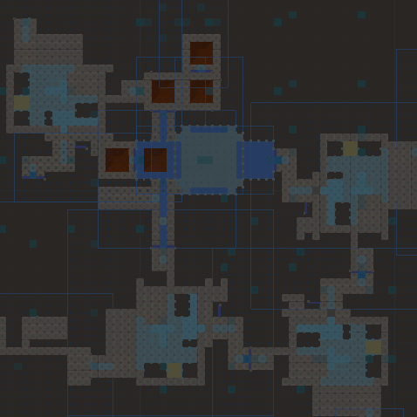
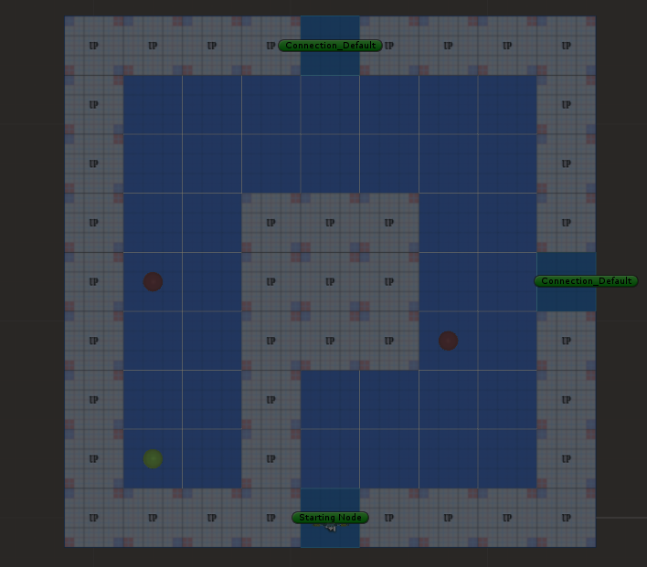
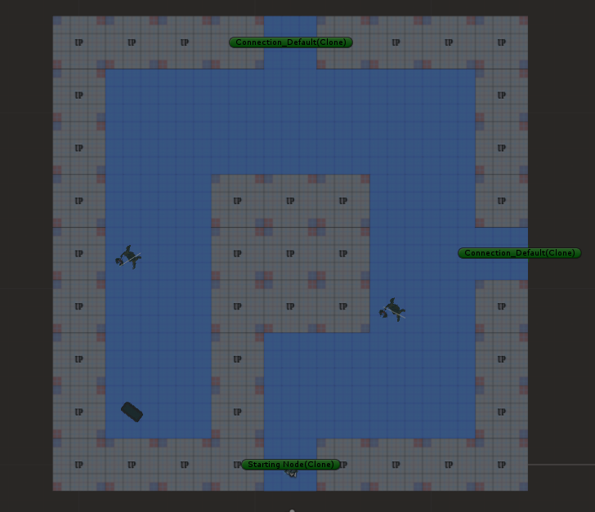
System Architecture
1. Create Mission Grammars
Mission Alphabet
Terminal nodes & non-terminal nodes
Mission Rules
圖片 需更換

Slide 21
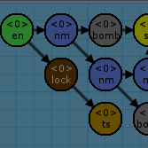

System Architecture
2. Create Volumes
Volex-based volumes
圖片 需更換

Slide 22
System Architecture
3. Generate the Space
Instructions of Rewrite System
圖片 需更換

Slide 23


System Architecture
4. Generate the Game Patterns
Genetic Algorithm for emergence objects
Nine main metrics to design the fitness functions
圖片 需更換

Slide 24
System Architecture
圖片需更換 為各結果圖
圖片 需更換

Slide 25
System DEMO
影片將會放置於此

Slide 26
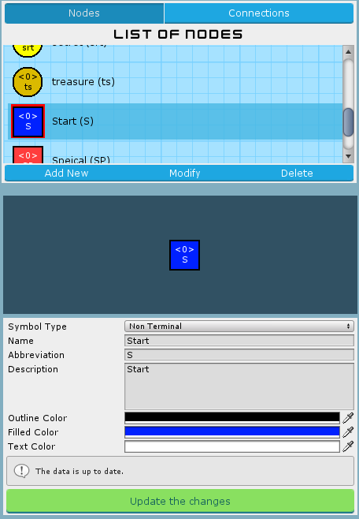
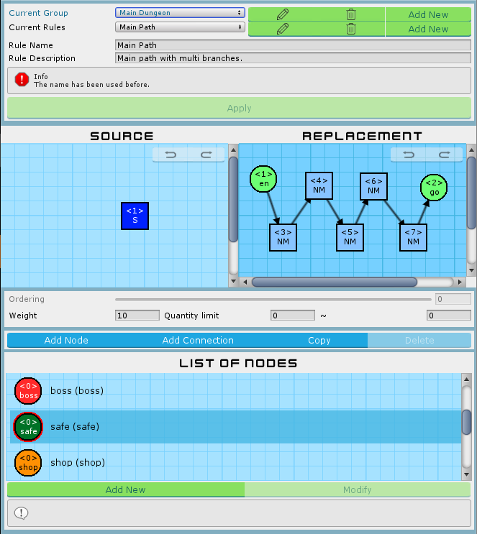
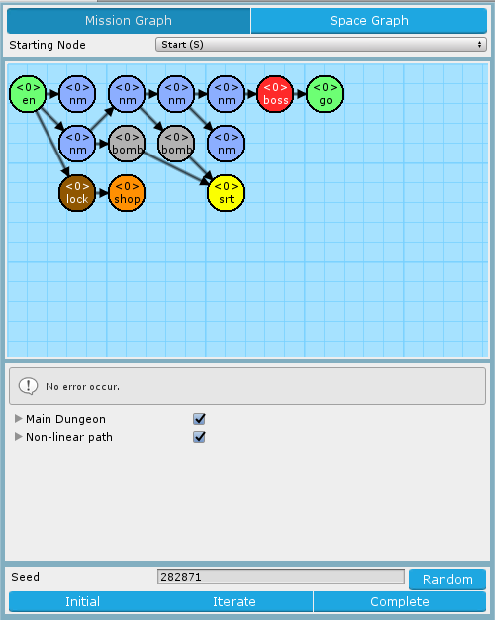
Mission Grammars
Mission Alphabet
Mission Rules
Mission Graph

Slide 27
Mission Alphabet

Slide 28
Mission Rules

Slide 29
Mission Graph

Slide 30
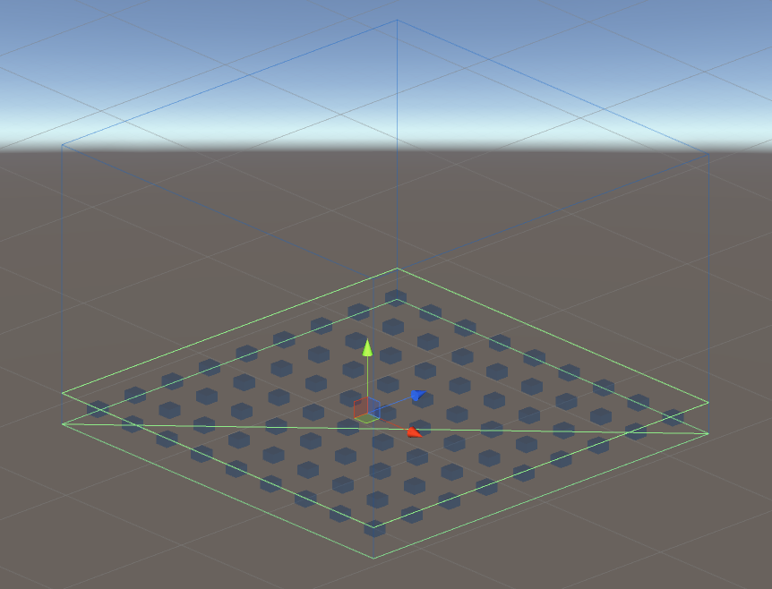
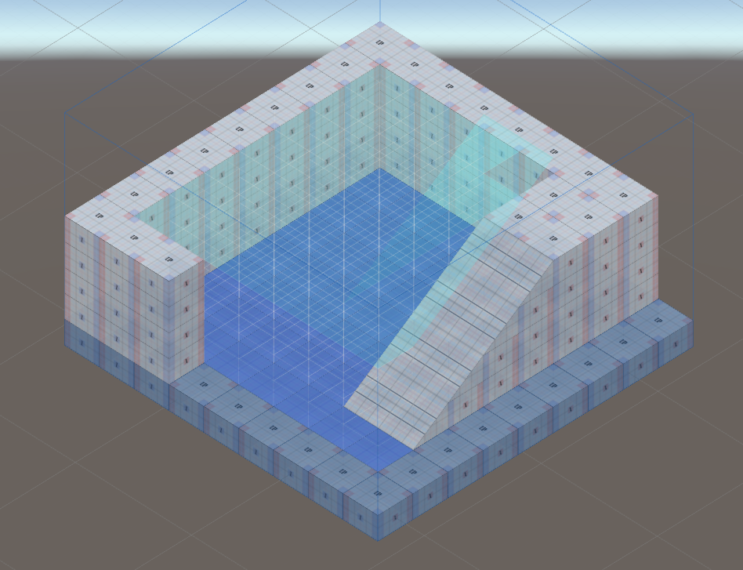
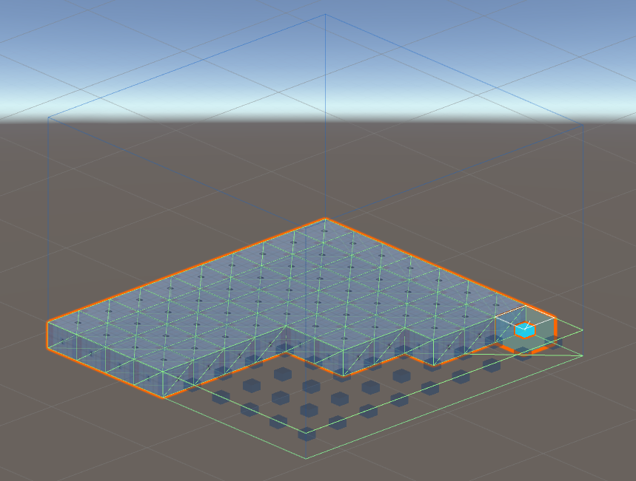
Room Definitions and Instruction
Editor
Voxel-based units
Decorations
Rewrite System
Instruction
Replacement

Slide 31
Voxel-based units in Editor

Slide 32
Decorations in Editor

Slide 33
Instruction of Rewrite System

Slide 34
Replacement of Rewrite System

Slide 35
Genetic Algorithm in Segments Evolution
Genetic Algorithm
Algorithm flow
Gene
Crossover
Mutation
Nine fitness functions
Neglected
Block
Intercept
Patrol
Guard
Dominated
Support
Cover
Trap

Slide 36
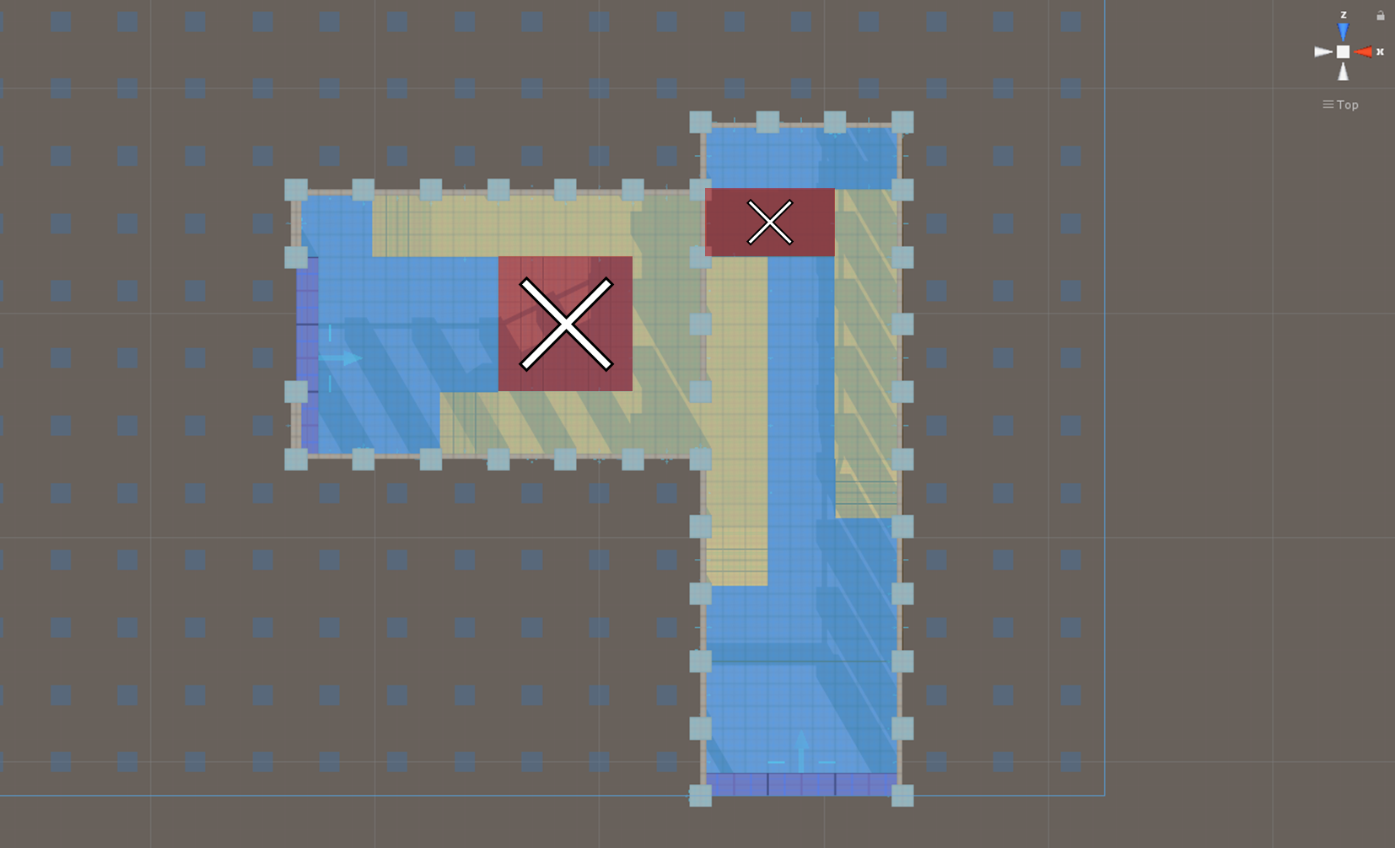
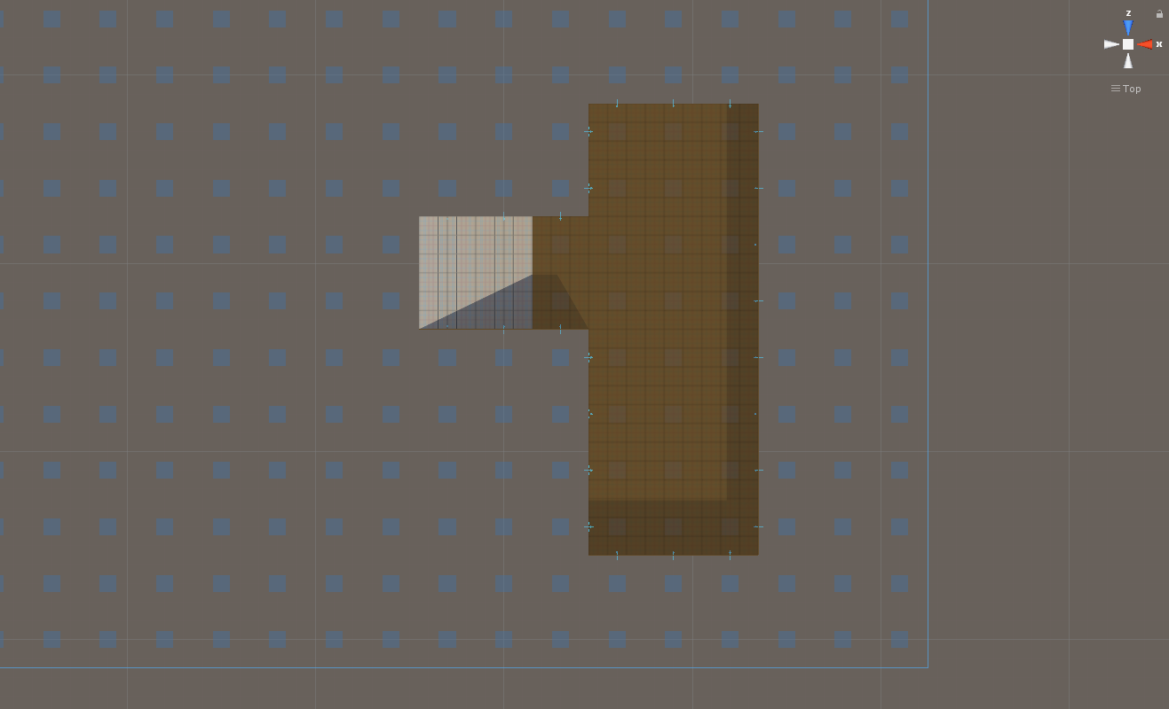


Gene
~
Basement
Gene Type
 | Empty
 | Enemy
 | Treasure
 | Trap
Gene
Ground
Individual (chromosome)
population

Slide 37
Crossover

Slide 38
Mutation

Slide 39
Experimental Results

Slide 41
Conclusions and Contributions

Slide 42
Conclusions

Slide 43
Contributions

Slide 44
Future Work

Slide 46
